Slide 1
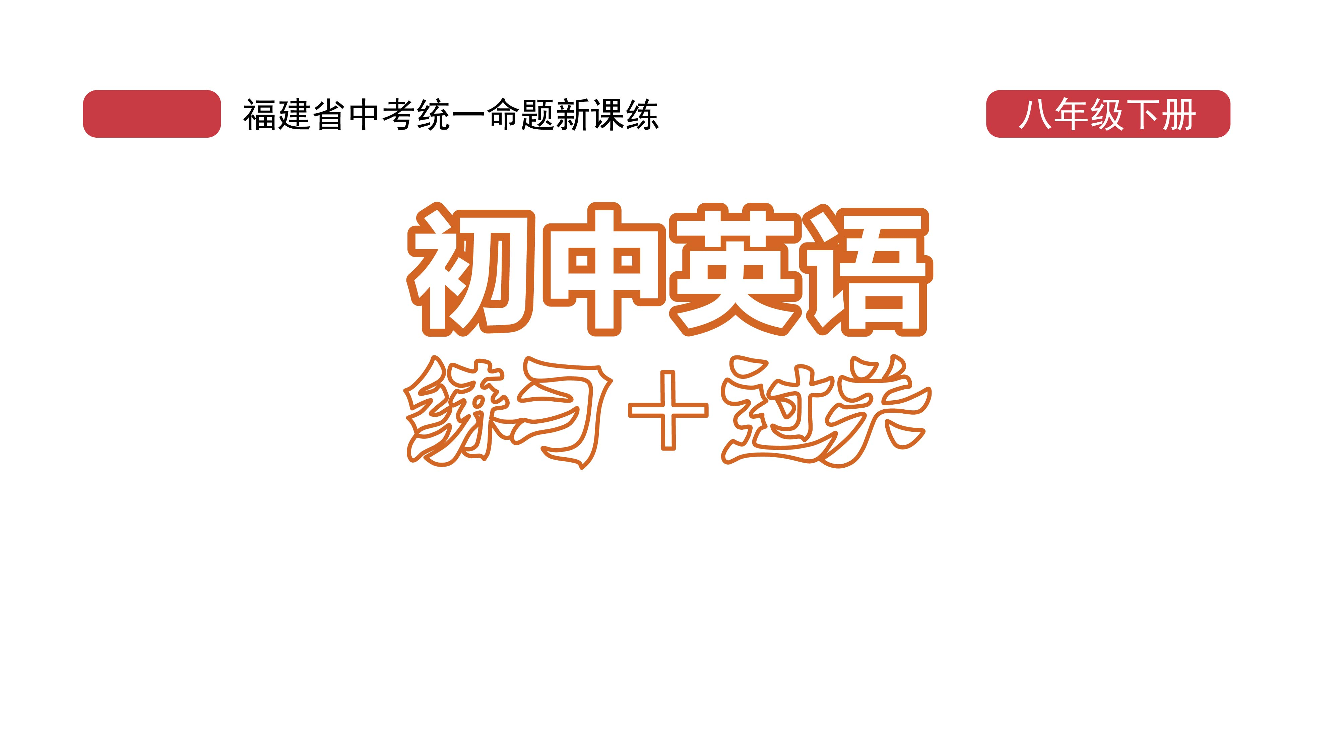
课时练习
模块七 第一章 第二节

Slide 2
一、翻译下列词组。
have a sweet tooth
western food
what’s more
good/well enough
1. 喜欢吃甜食 __________________________
2. 西方食物 ________________________________
3. 而且 __________________________
4. 足够好 ____________________________

Slide 3
一、翻译下列词组。
It’s a pleasure.
invite sb. to …
send sb. an email/send an email to sb.
later on
5. 不用谢； 乐意为您效劳。 ________________
6. 邀请某人到…… _________________________
7. 给某人发一封邮件 _______________________
8. 稍后 ____________________________

Slide 4
二、根据语境、音标或所给单词的提示完成句子， 每空一词。
1. If you want to know more about_________(India) culture, the story behind the Taj Mahal(泰姬陵) cannot be missed.
2. In_______/ˈæfrɪkən/ languages, there is a close correspondence(关联) between sounds and letters.
Indian
African

Slide 5
二、根据语境、音标或所给单词的提示完成句子， 每空一词。
3. Traditional Chinese medicine is now popular in many_________(west) countries.
4. My email________is ZX1357@163.com.
5. The________/ˈrʌʃn/ cats have thick fur to protect them from the cold.
Western
address
Russian

Slide 6
三、单项选择。
( )1.Visitors must_____their health QR codes(二维码) and have their temperature checked before they go into the museum.
A. touch B. show C. notice
B

Slide 7
三、单项选择。
( )2. —I wonder______________.
—In Xichang, Sichuan.
A. when China sent the last Beidou Satellite(北斗卫星) B. where did China send the last Beidou Satellite C. where China sent the last Beidou Satellite
C

Slide 8
三、单项选择。
( )3. The book is______, but I don’t have_____to buy it.
A. interesting enough; enough money
B. enough interesting; enough money
C. interesting enough; money enough
A

Slide 9
三、单项选择。
( )4. Taking the subway is good for the environment. _______ , you won’t get stuck in the traffic jam(拥堵).
A. For example B. What’s more
C. However
B

Slide 10
三、单项选择。
( )5. —Andy, thanks for helping me find my dog!
—_________________.
A. Never mind B. That’s right C. It’s a pleasure
C

Slide 11
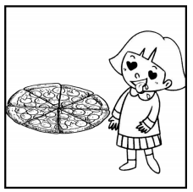
四、看图写话。
1. think, delicious
The girl/She thinks the pizza is delicious.

Slide 12
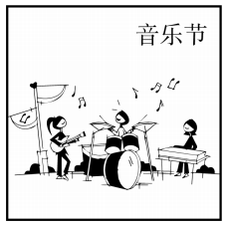
四、看图写话。
2. there be, next weekend
There will be/There is going to be a music festival next weekend.

Slide 13
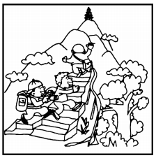
四、看图写话。
3. plan, tomorrow
The children/They plan to go ( moutain ) climbing tomorrow.

Slide 14
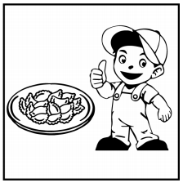
四、看图写话。
4. sure, popular
The boy/ He is sure the dumpings will be popular.

Slide 15
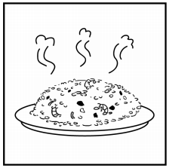
四、看图写话。
5. taste
The fried rice tastes delicious.

Slide 16


